Slide 1


Slide 2
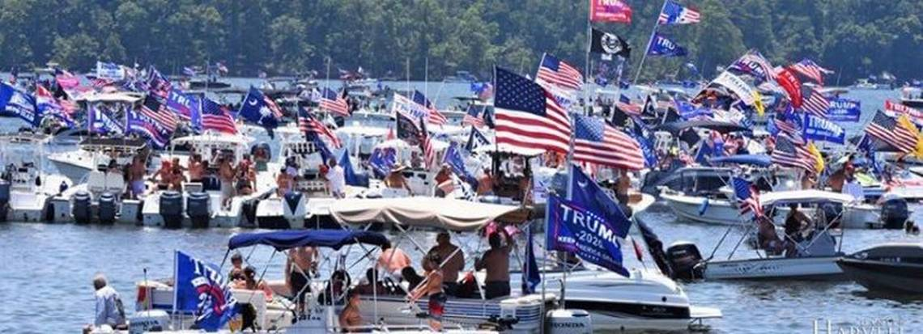
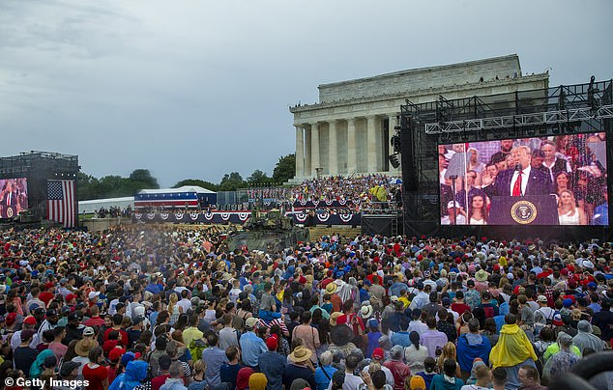
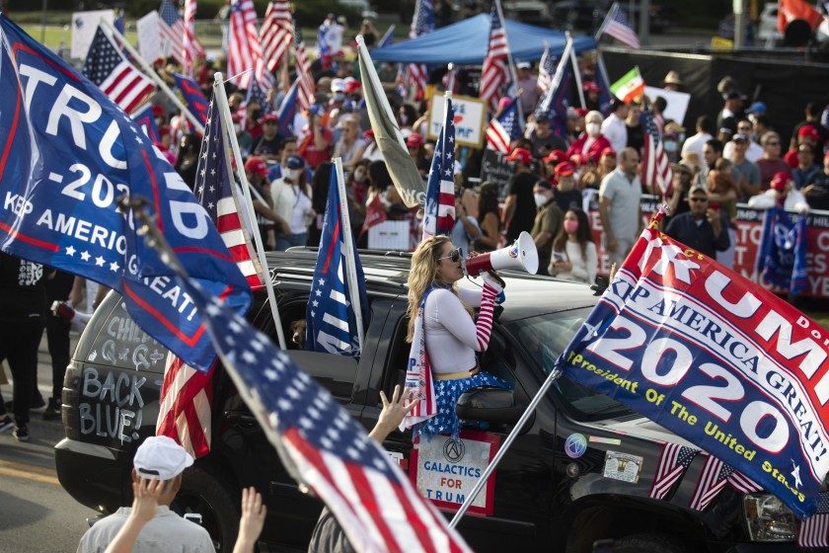
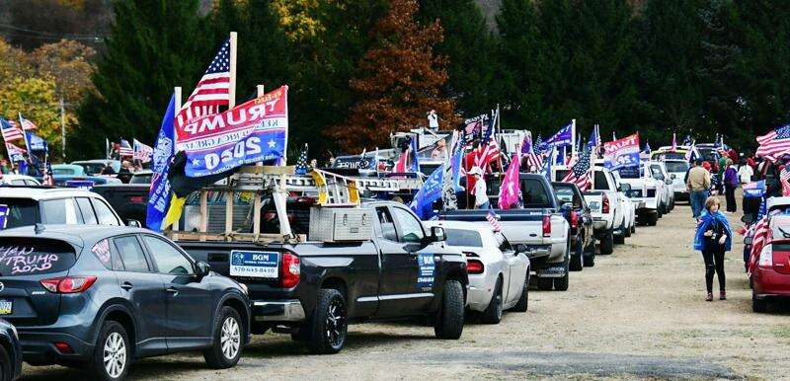
Let us stand 1776 STRONG as Americans and restore the American Republic!
Let 1776 STRONG be Our Battle Cry for Freedom Across the Land!
Let us stand 1776 STRONG, united in American Values, Culture, and Faith.
As the LEFT seeks to silence us at every turn, let’s send the left a clear message.
We love the United States of America!
We are proud to be called Americans!
This is OUR COUNTRY! We are 1776 STRONG!
Stand up to Marxists and Socialists who seek to forever change our Republic and strip away our freedoms enshrined in our Constitution.
Unite and Ignite our National Pride!
Stand Together 1776 STRONG!

Slide 3
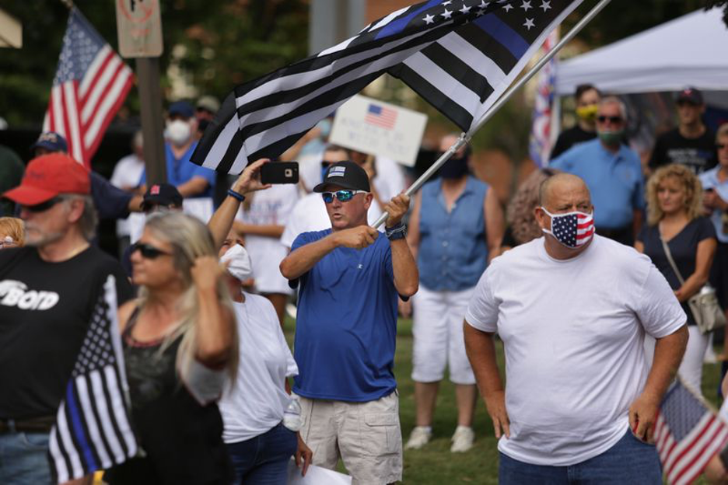
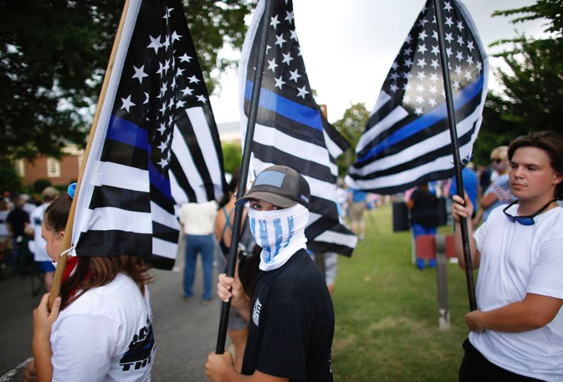
1776 STRONG
We, the Republic, cannot afford to lose any more battles through fair or unfair circumstances. We must stand together, everyone acting together, to safeguard our Nation.
We must stand together, determined never to rest our fate, freedoms, and our future into the hands of RINO’s and Leftists.
We must stand together, vigilant to root out and replace bad actors wherever they roost.
We must stand together, electing only true Patriots who love our country, love and respect our Constitution, and will stand 1776 STRONG.

Slide 4
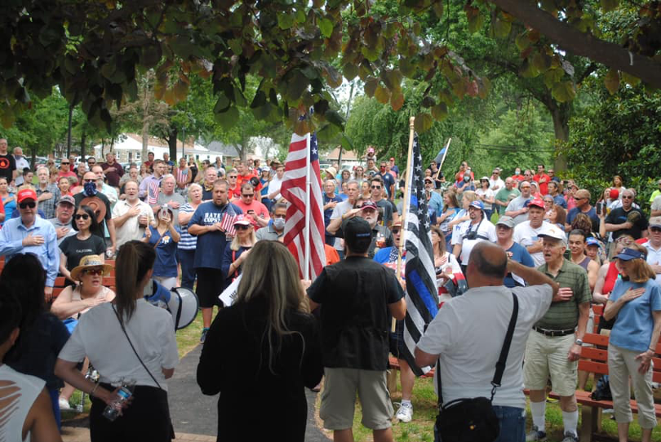
Let’s Unite and Stand 1776 STRONG!
1776 STRONG is a public declaration to stand strong for America, stand for our Constitution and our Freedoms! Let’s stand proudly with our Founding Fathers and share the Spirit of 1776 as one undivided United States of America. This is OUR COUNTRY, and we are forever 1776 STRONG!
1776 STRONG is a nationwide movement uniting our conservative base to fight the Lefts march against our American History, Freedoms, Culture and Prosperity.
1776 STRONG is designed to assemble our great community of patriots towards unified, strategic wins.
1776 STRONG is a network of localized groups, fighting together, to win critical battles including Election Integrity, Law and Order, and the Woke Culture War.

Slide 5
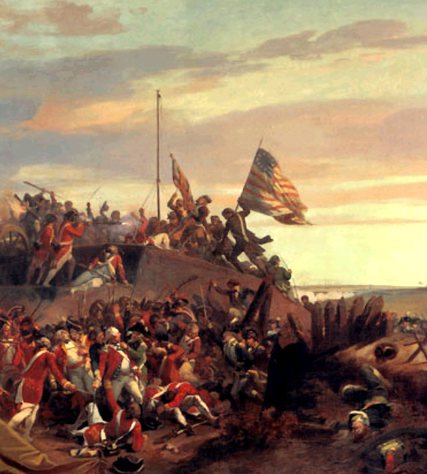
1776 STRONG
Boldly Defends The United States of America
- Our shared identity as Americans
- Our Constitution and Bill of Rights
- Our Founders, military and our flag
- Conservatism and Traditional Values
- The Nuclear Family
- Life, Liberty and The Pursuit of Happiness for ALL
- American Exceptionalism
- Our right to assemble and speak freely
Boldly Defends Against:
-Democratic Reconstruction of our Government
-Marxism and Socialism
-1619 Agenda
-Critical Race Theory
-Institutionalized Racism and Identity Politics

Slide 6
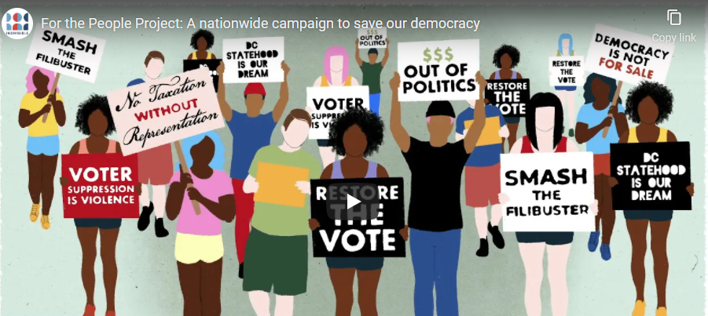
Democrats Final Push
Democrats are strategically organizing to deliver a final death blow to our Republic. The Democrats are now deploying a strategy taken right out of the Marxist Revolutionary Textbooks!
REPLACE our Republic’s Constitutional Government with a Democratic Socialist Totalitarian and Oligarchy Regime
Fraudulently Manipulate our Voting Process for a Forever Power Grab.
Abolish States Right to Control Elections
Demonize, Defund and Destroy our Police and Law Enforcement
D.C. and Puerto Rico Statehood
Weaponize the Media, Social Media and Big Corporations, as one “Ministry of Propaganda” party machine
Censorship of Conservatives
Green New Deal
Infrastructure Scheme
Destroy the Middle Class and Small Business
Abolish the Filibuster
Stack the Supreme Court
Abolish 2nd Amendment Rights
Destroy our immigration process and transform America through open borders
Conservatives Must Strategically Organize
While the Democrats have us debating Critical Race Theory, Police Brutality and Discrimination, White Fragility, Identity Politics, Health Care, and Gender Confusion……. the Left has been working tirelessly at something FAR MORE SINISTER: Transforming America Through Democratic Socialist Regime Change.
Stand 1776 STRONG and Save Our Republic!

Slide 7
This is Our Time of Choosing
President Ronald Reagan said
1776 STRONG
“This is the issue:
Whether we believe in our capacity for self-government or whether we abandon the American revolution and confess that a little intellectual elite in a far-distant capitol can plan our lives for us better than we can plan them ourselves.”
Protect the Republic
Protect the Filibuster
Protect the Supreme Court
Protect the US Constitution
Abolish Race Hustling
Abolish Identity Politics
Abolish 1619 Project

Slide 8
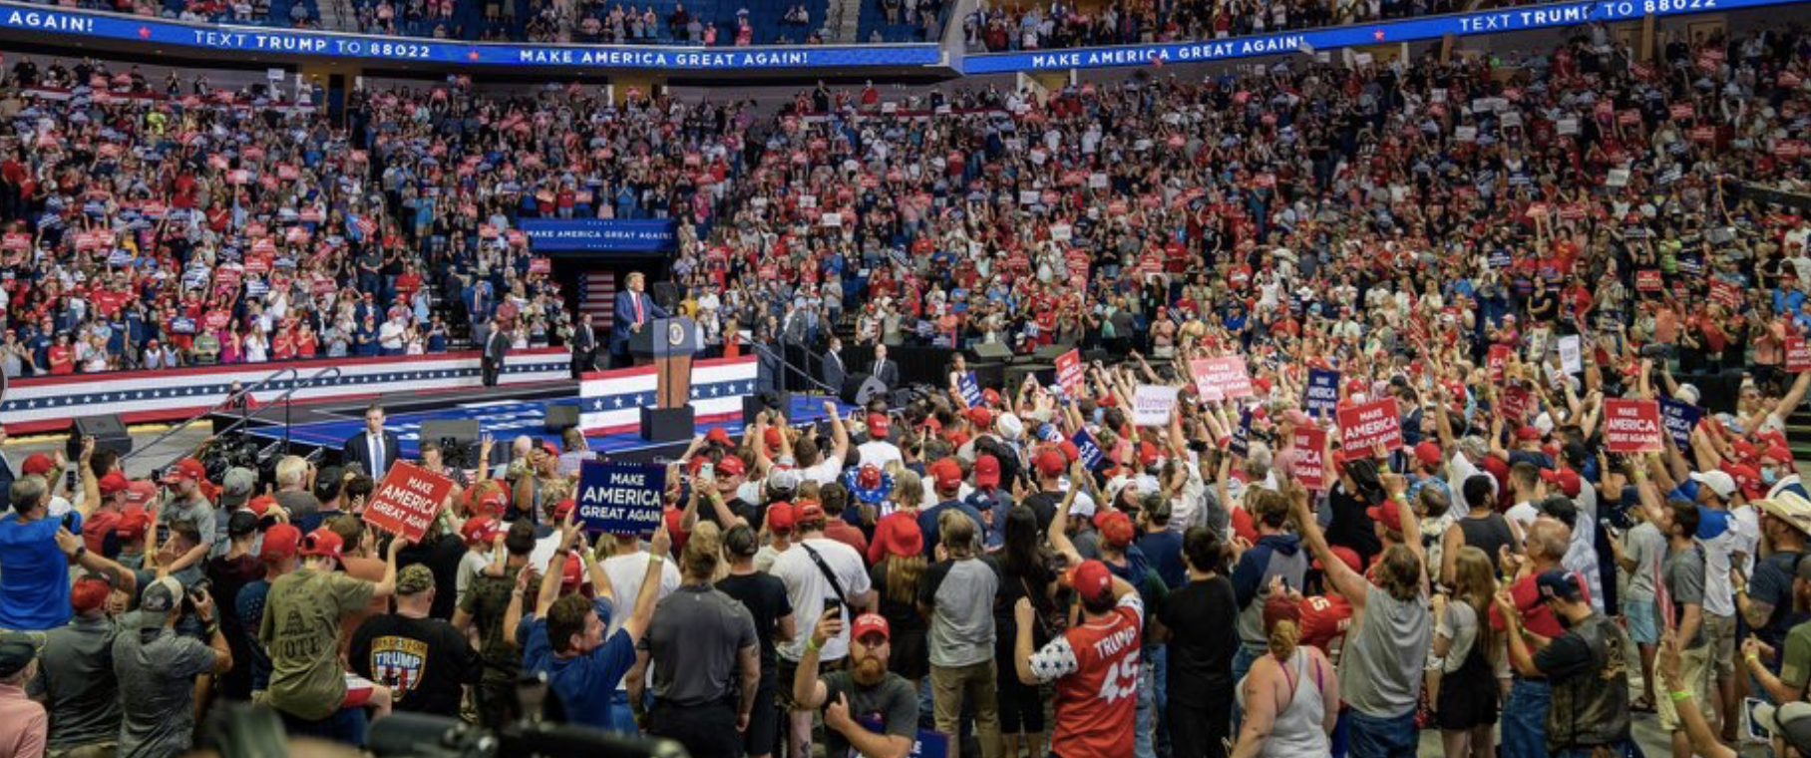
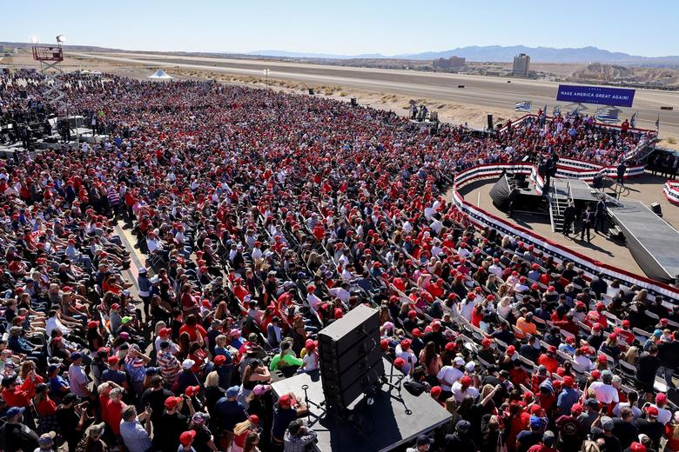
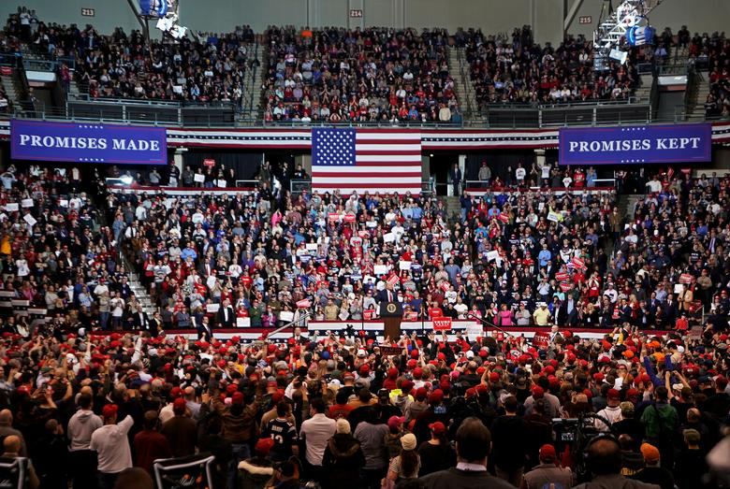
No Longer Silent MAJORITY
We’re Alive, We Believe, We’re Here to Stay
We are 1776 STRONG!

Slide 9
Stand With Us and Save Our Republic

